Slide 1

Modern Block Cipher Standards (AES)
Debdeep Mukhopadhyay
and Mainack Mondal
CS 60065
Autumn 2020

Slide 2
Finite Fields
A finite field is a field with a finite number of elements.
The number of elements in the set is called the order of the field.
A field with order m exists iff m is a prime power, i.e m=p^{n} for some integer n and with p a prime integer.
p is called the characteristic of the finite field.

Slide 3
Complex Fields
GF(p): The elements of the fields can be represented by 0, 1, …, p-1
However if p is not prime, then multiplications are not defined.
However for finite fields GF(p^{n}), with n>1, slightly complex representations are used.
Elements are represented as polynomials over GF(p).

Slide 4
Polynomials over a field

Slide 6
Operations on Polynomials
Addition:

Slide 7
Example

Slide 8
Multiplication
Associative
Commutative
Distributive wrt. addition of polynomials.

Slide 9
Irreducible Polynomial
A polynomial d(x) is irreducible over the field GF(p) iff there exist no two polynomials a(x) and b(x) with coefficients in GF(p) such that d(x)=a(x)b(x), where a(x) and b(x) are of degree > 0.

Slide 10
Example
Degree | Irreducible Polynomial
1 | (x+1),x
2 | (x²+x+1)
3 | (x³+x²+1), (x³+x+1)
4 | (x⁴+x³+x²+x+1), (x⁴+x³+1),(x⁴+x+1)

Slide 11
Addition and Multiplication in GF(2^{n})
Addition can be implemented using only XOR operation.
Multiplication can be implemented using shift-left and XOR operation.

Slide 12
Concept of generator
It is often easy to define the elements in a field using a generator.
Consider an irreducible polynomial f(x).
Say, x=g, is the solution for f(x)=0.
It can be proved that all the elements of the field GF(2^{n}) can be expressed as:
{0, g, g², g³, …, g^{N}}, where N=2^{n}-2

Slide 13
Example
Generate all the elements of the field GF(2⁴) using the irreducible polynomial, f(x)=x⁴+x+1.

Slide 14
Introduction to AES
In 1999, NIST issued a new standard that said 3DES should be used
168-bit key length
Algorithm is the same as DES
3DES had drawbacks
Algorithm is sluggish in software
Only uses 64-bit block size

Slide 15
Introduction to AES (Cont.)
In 1997, NIST issued a CFP for AES
security strength >= 3DES
improved efficiency
must be a symmetric block cipher (128-bit)
key lengths of 128, 192, and 256 bits

Slide 16
Introduction of AES (cont.)
First round of evaluation
15 proposed algorithms accepted
Second round
5 proposed algorithms accepted
Rijndael, Serpent, 2fish, RC6, and MARS
Final Standard - November 2001
Rijndael selected as AES algorithm

Slide 17
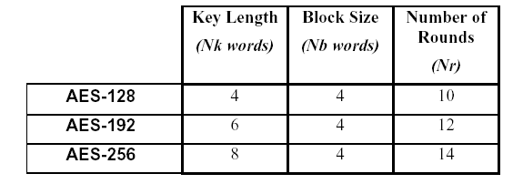
Rijndael Algorithm

Slide 18
Difference between Rijndael and AES
Rijndael is a block cipher with both a variable block length and a variable key length.
The block and key lengths can be independently fixed to any multiple of 32, ranging from 128 to 256 bits.
The AES fixes the block length to 128 bits, and supports key lengths of 128, 192 and 256 bits.

Slide 19
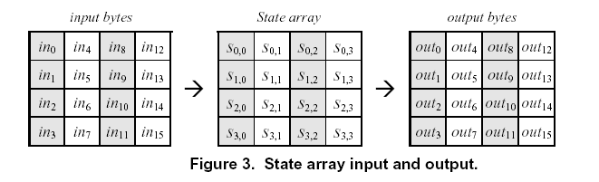
Rijndael Algorithm

Slide 20
Rijndael Algorithm
In Rijndael, there are four round functions.
(1) Byte Sub
(2) Shift Row
(3) Mix Columns
(4) Add Round Key

Slide 21
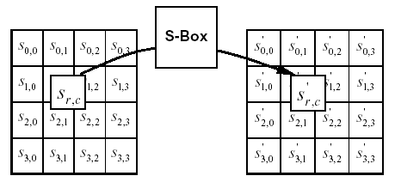
Byte Sub

Slide 22
The AES SBox
Based on the mapping defined by K. Nyberg, published in Eurocrypt 1993.
The input is an eight bit value, a. Here, a is in GF(2⁸).
The SBox is based on the mapping:

Slide 24
The AES SBox
In addition no fixed points or opposite fixed points were desired.
Hence an affine mapping was defined.

Slide 25
The AES S-Box Affine mapping

Slide 26
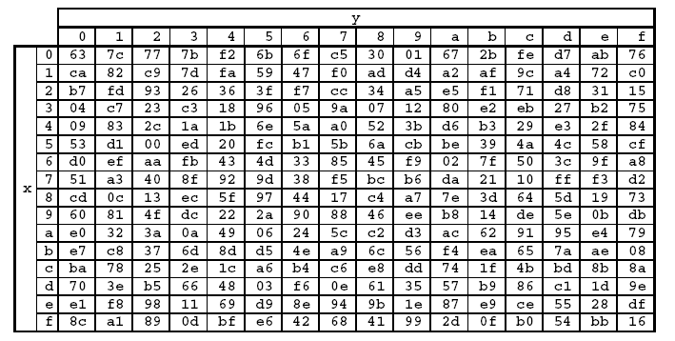
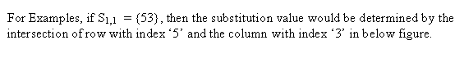
S-Box

Slide 27
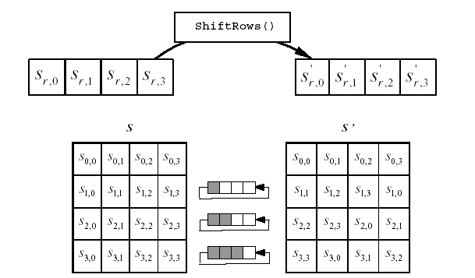
Shift Row

Slide 28
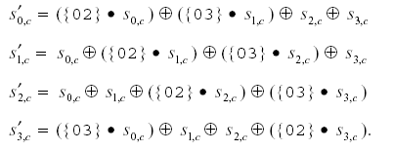
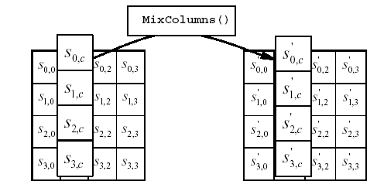
Mix Columns
Mix Columns:

Slide 30
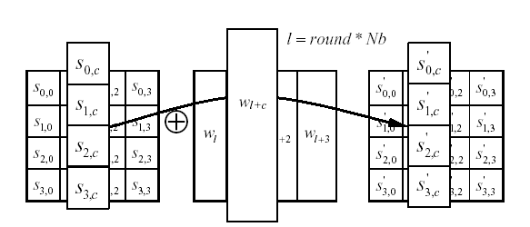
Add Round Key

Slide 31
Modern Block Cipher Standards (AES) (contd.)

Slide 32
Objectives
The AES Key scheduling
The AES Decryption function
Implementation of the AES Round on modern processors

Slide 33
The AES KeyScheduling
Efficiency:
Low working memory
Performance on a wide range of processors
Symmetry elimination: use round constants to eliminate symmetricity
Diffusion: High diffusion of cipher key differences into the expanded key
Non-linearity: Exhibit high non-linearity to prevent the determination of differences in the expanded key from that of the input key.

Slide 34
Key Expansion
The AES algorithm takes the Cipher Key, K, and performs a Key Expansion routine to generate a key schedule.
The Key Expansion generates a total of Nb (Nr + 1) words: the algorithm requires an initial set of Nb words, and each of the Nr rounds requires Nb words of key data.
Key Expansion includes the following functions :
(1)RotWord : Takes a word [a₀,a₁,a₂,a₃] as input , performs a cyclic permutation, and returns the word [a₁,a₂,a₃,a₀]
(2)SubWord : is a function that take a 4-bytes input word and applies the S-box to each of the four bytes to produce and output word.
(3)Rcon[i/NK] : contains the values given by [x^{i-1}, {00},{00},{00}], with x^{i-1} being powers of x (x is denoted as {02}) in the field GF(2⁸).

Slide 35
The Key Scheduling Algorithm for Nk≤6
keyexpansion(byte key[4*Nk],word w[(Nr+1)*Nb],Nk)
word temp; i=0;
while (i<Nk)
{ w[i]={key[4i],key[4i+1]key[4i+2]key[4i+3]};
i=i+1;
}

Slide 36
The Key Scheduling Algorithm for Nk≤6
while(i<Nb(Nr+1)){
temp=w[i-1];
if(i mod Nk = 0)
temp= Subword(Rotword(temp)) xor Rcon[i/Nk];
w[i]=temp xor w[i-Nk];
i=i+1;
}

Slide 37
The Round Constant
Each round constant is a 4 byte value, where the right most three bytes are always 0.
The left byte is equal to x^{i-1}, where x is an element in GF(2⁸)
The Round Constants can be either obtained from a table or computed by multiplication in GF(2⁸), where m(x)=x⁸+x⁴+x³+x+1 is the reduction polynomial.

Slide 38
Powers of x in GF(2⁸)
RC₁ = x¹⁻¹=x⁰ = 0000 0001 = 01₁₆
RC₂ = x²⁻¹ = x = 0000 0010 = 02₁₆
RC₃ = x³⁻¹ = x² = 0000 0100 = 04₁₆
RC₄ = x⁴⁻¹ = x³ = 0000 1000 = 08₁₆
RC₅ = x⁵⁻¹ = x⁴ = 0001 0000 = 10₁₆
RC₆ = x⁶⁻¹ = x⁵ = 0010 0000 = 20₁₆
RC₇ = x⁷⁻¹ = x⁶ = 0100 0000 = 40₁₆
RC₈ = x⁸⁻¹ = x⁷ = 1000 0000 = 80₁₆
RC₉ = x⁹⁻¹ = x⁸ = 0001 1011 = 1B₁₆
RC₁₀ = x¹⁰⁻¹ = x⁹= 0011 0110 = 36₁₆

Slide 39
When Nk>6…
while(i<Nb(Nr+1)){
temp=w[i-1];
if(i mod Nk = 0)
temp= Subword(Rotword(temp)) xor Rcon[i/Nk];
if(i mod Nk=4)
temp = Subword(temp);
w[i]=temp xor w[i-Nk];
i=i+1;
}

Slide 40
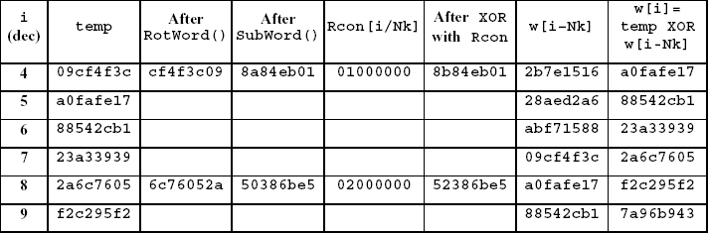
Key Expansion
Expansion of a 128-bit Cipher Key:
This section contains the key expansion of the following cipher key:
Cipher Key = 2b 7e 15 16 28 ae d2 a6 ab f7 15 88 09 cf 4f 3c
for Nk = 4, which results in
w0 = 2b7e1516 w1 = 28aed2a6 w2 = abf71588 w3 = 09cf4f3c

Slide 41
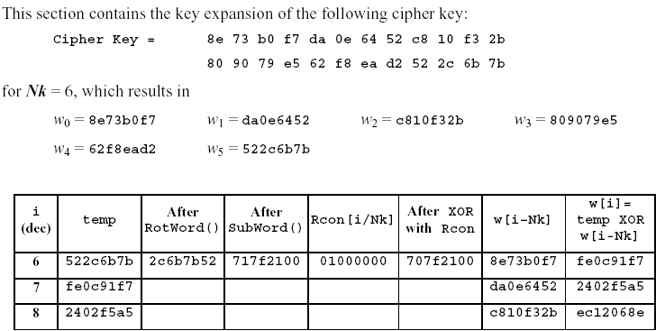
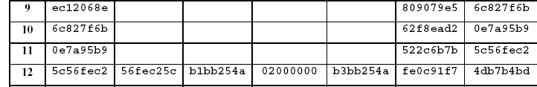
Key Expansion (192-bit Cipher Key)

Slide 42
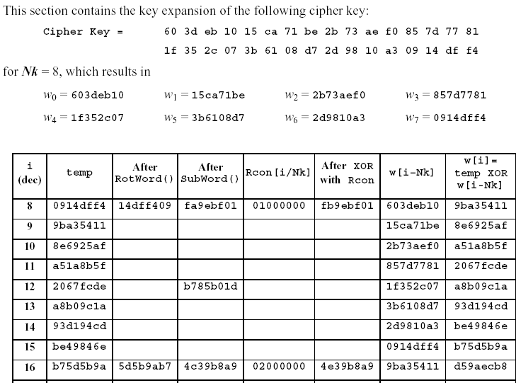
Key Expansion(256-bit Cipher Key)

Slide 43
Algorithm of Encryption process
Cipher (byte in[4*Nb],byte out[4*Nb],word w[Nb*(Nr+1)]
begin
byte state [4,Nb];
state = in;
AddRoundKey(state, w[0,Nb-1];
for(round=1 to Nr-1)
begin
SubBytes(state);
ShiftRow(state);
MixColumn(state);
AddRoundKey(state, w[round*Nb, (round+1)*Nb-1];
end

Slide 44
Last Round of AES encryption
SubBytes(state);
ShiftRow(state);
AddRoundKey(state, w[Nr*Nb, (Nr+1)*Nb-1];
out=state;

Slide 45
Inverse Cipher (decryption)
The cipher transformations can be inverted and then implemented in reverse order to produce a straightforward Inverse Cipher for the AES Algorithm. The individual of transformation used in the Inverse Cipher process the state.
InvshiftRows( )
InvSubBytes( )
InvMixColumn( )
AddRoundKey( )

Slide 46
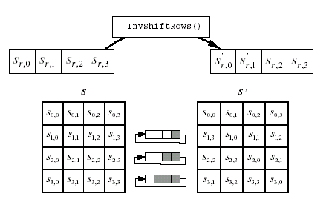
InvShiftRows( )

Slide 47
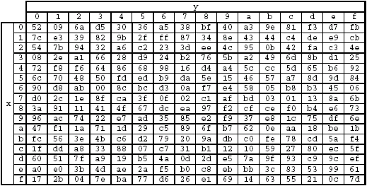
Inverse S-Box

Slide 48
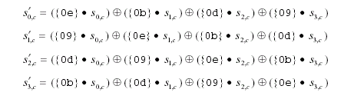
InvMixColumns

Slide 49
Algorithm of Decryption process
InvCipher (byte in[4*Nb],byte out[4*Nb],word w[Nb*(Nr+1)]
begin
byte state [4,Nb];
state = in;
AddRoundKey(state, w[Nr*Nb, (Nr+1)*Nb-1];
for(round= Nr-1 to 1)
begin
InvShiftRow(state);
InvSubBytes(state);
AddRoundKey(state, w[round*Nb, (round+1)*Nb-1];
InvMixColumn(state);
end

Slide 50
Last Round of AES decryption
InvShiftRow(state);
InvSubBytes(state);
AddRoundKey(state, w[0, Nb-1];
out=state;

Slide 51
Some Points
The order of InvShift Rows and InvSubBytes is indifferent.
The order of AddRoundKey and InvMixColumns can be inverted if the round key is adapted accordingly.

Slide 52
A Linear transformation can be pushed through an XOR
k
x
L
L(x k)
k
L
x
L
L(x k)

Slide 53
Encryption steps for two round AES variant
AddRoundKey(State, ExpandedKey[0]);
SubBytes(State);
ShiftRow(State);
MixColumn(State);
AddRoundKey(State, ExpandedKey[1]);
SubBytes(State);
ShiftRow(State);
AddRoundKey(State, ExpandedKey[2]);

Slide 54
Decryption steps for two round AES variant
AddRoundKey(State, ExpandedKey[2]);
InvShiftRow(State);
InvSubBytes(State);
AddRoundKey(State, ExpandedKey[1]);
InvMixColumn(State);
InvShiftRow(State);
InvSubBytes(State);
AddRoundKey(State, ExpandedKey[0]);

Slide 55
Equivalent Decryption steps for two round AES variant
AddRoundKey(State, ExpandedKey[2]);
InvSubBytes(State);
InvShiftRow(State);
InvMixColumn(State);
AddRoundKey(State, EqExpandedKey[1]);
InvSubBytes(State);
InvShiftRow(State);
AddRoundKey(State, ExpandedKey[0]);

Slide 56
Equivalent Decryption
The equivalent key-scheduling can be obtained by applying InvMixColumns after the key-scheduling algorithm.
This can be generalized to the full round AES.
Thus we see that in the equivalent decryption the sequence of steps is similar.
This helps implementation

Slide 57
Implementation on modern processors
Different steps of the round transformation can be combined in a single set of look up tables.
This allows very fast implementation on processors with word length 32 or greater.

Slide 58
AES on the table!

Slide 59
AES on the table!

Slide 60
AES on the table!

Slide 61
Cost of the table(s)
Each table has 256 entries of size 4 bytes. Thus each table is of 1 kB.
Since AddRoundKey can be implemented by additional 32 bit XOR, AES round can be implemented with 4 kB of tables, with 4 table look ups and one XOR per column per round.
Note that final round does not have a Mixcolumn step.
Using some additional simple operations, the 4 tables can be reduced to 1. (How?)

Slide 62
Further Reading
Douglas Stinson, Cryptography Theory and Practice, 2nd Edition, Chapman & Hall/CRC
Joan Daemen, Vincent Rijmen, “The Design of Rijndael”, Springer Verlag

Slide 63
Exercise
Convince yourself that diffusion takes place very fast in AES.
How many rounds are necessary for a one byte diffusion to spread to the entire AES state matrix?

Slide 64
Number of rounds of AES-128
Two rounds provide full diffusion
Short cut attacks exist on 6 rounds of AES-128.
As a conservative approach, two rounds of diffusion are provided at the beginning and two at the end, thus explaining the 10 rounds.

Slide 65
Number of rounds
Number of rounds increased by 1 for every 32 bits additional key bits.
The main reason is we need to avoid short cut attacks. Since with the increase in key size, the exhaustive key search grows exponentially, the short cut attacks will work for larger number of rounds than for AES-128.

Slide 66
Attacks on reduced variants
Linear Cryptanalysis
Differential Cryptanalysis
Related key attacks
Boomerang attacks
Square attacks

Slide 67
Next days topic
Cryptanalysis of Block Ciphers:
Linear Cryptanalysis

